Slide 1
This is a title Here is names and IDs

Slide 2
Monolithic architecture vs Microservice architecture

Slide 3
Monolithic Architecture

Slide 4
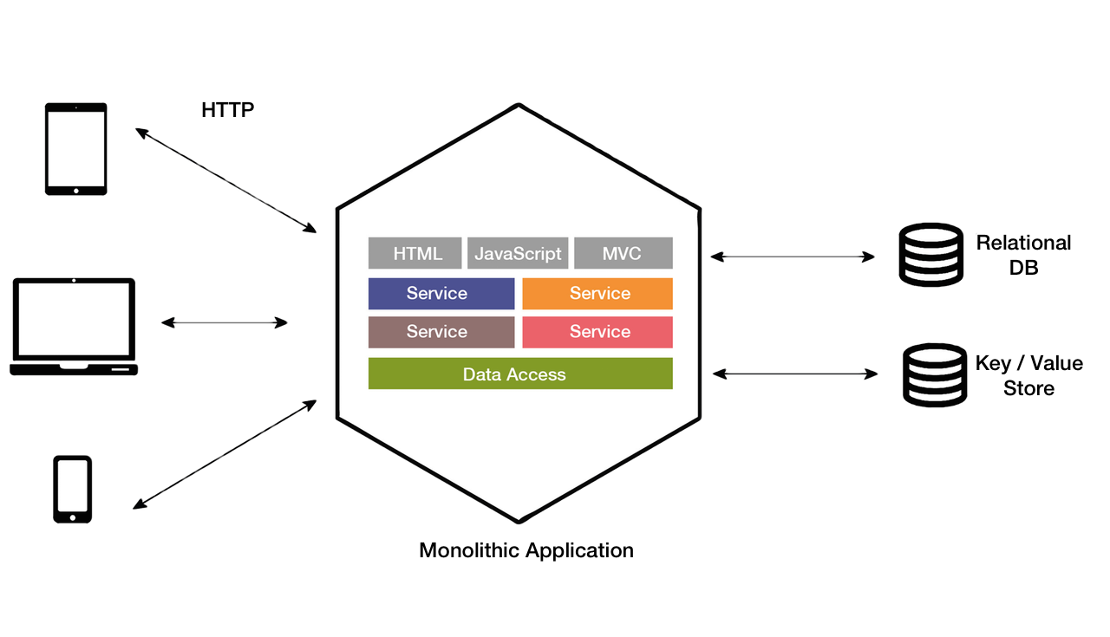
Overview

Slide 5
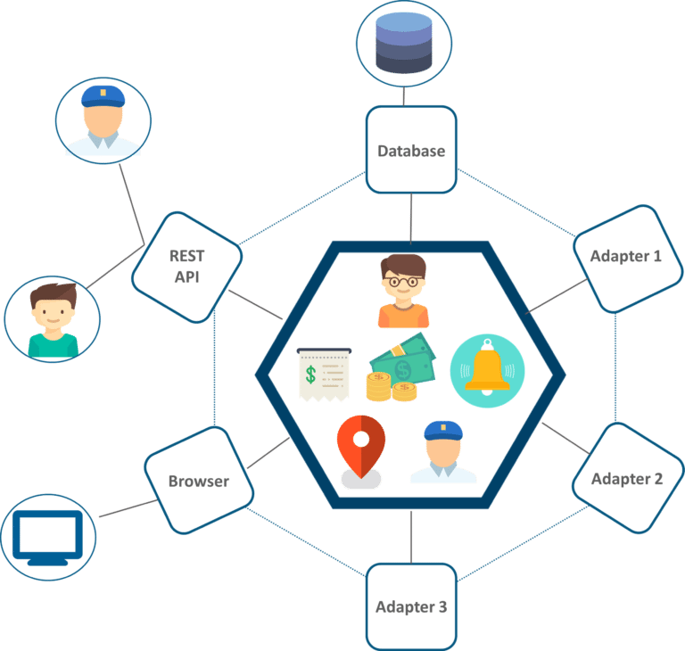
Example: Uber’s old architecture
Problems?

Slide 6
Benefits
-Easy to develop and test
-Easy to deploy
-Easy to scale
Drawbacks
-Difficult to understand and modify codes
-Obstacle to scaling development
-Overloaded web container and IDE
Improvement
-Microservice architecture

Slide 7
Microservice Architecture

Slide 8
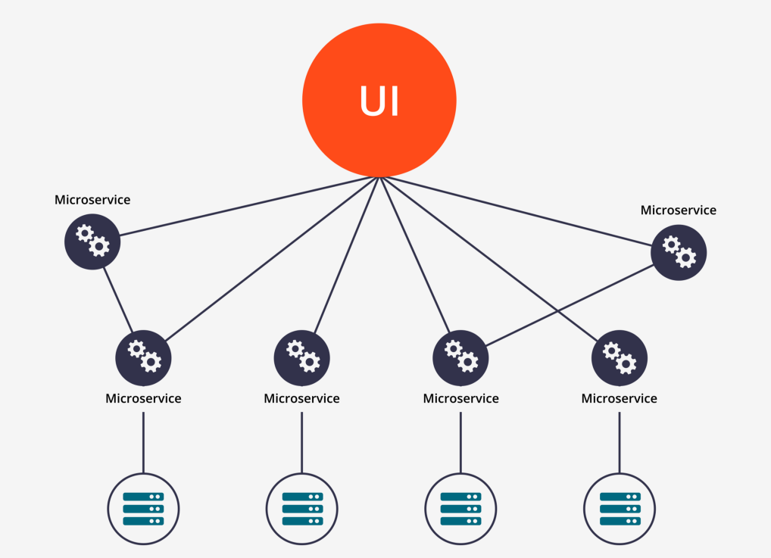
Overview

Slide 9
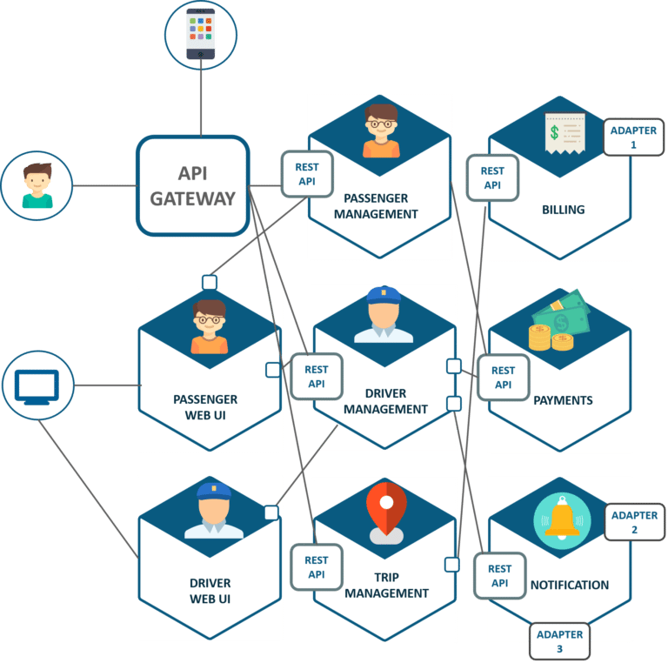
Example: Uber’s new architecture

Slide 10
Benefits:
-Technology Independent
-Availability
-Release and deployment
-Scalability
Drawbacks:
-Boundary definition between services
-Latency
-Consistency
-Infrastructure automation

Slide 11
Conclusion

Slide 12
ACID & CAP

Slide 13
ACID Properties

Slide 14
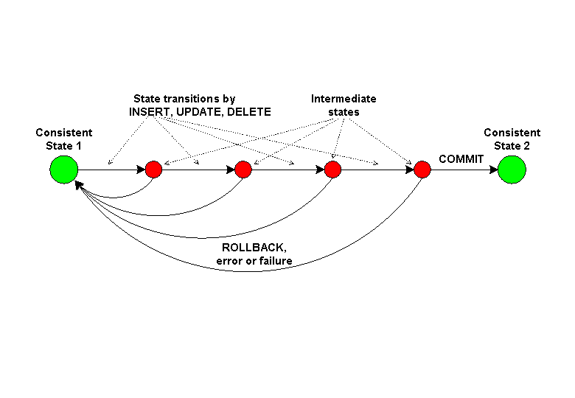
Atomicity
Consistency Isolation
Durability
Database transaction

Slide 15
CAP Theorem

Slide 16
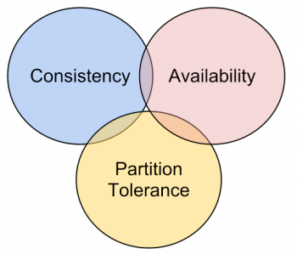
Consistency
Availability
Partition tolerance
The tradeoff among the C,A and P.

Slide 17
Consistency in ACID and CAP

Slide 18
Thank you!

